Slide 1
Website Address

Slide 2
Website Address
A URL like
www.bbc.co.uk
Or
http://bbc.co.uk
Can be purchased

Slide 3
Website Address
Also others like
.org.uk
.biz.uk
.eu
.tv

Slide 4
Website Address
But these are just a names
To find an actual website they need to be linked to a number

Slide 5
IP address
An Internet Protocol address like
212.58.251.195
www.bbc.co.uk
So various address’ can link to this number

Slide 6

IP address
This is what
www.icann.org
Control

Slide 7
IP address
The database lists of names and numbers is stored in 13 DNS servers across the world

Slide 8
IP address
These are “looked up” between you typing an address and the webpage being displayed – This is resolving an address

Slide 9
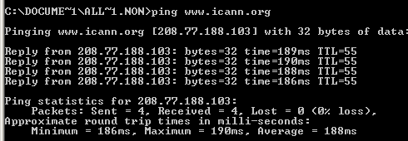
IP address

Slide 10
